Slide 1


Disruptor

Slide 2
Pace of technology adoption is faster than ever
Global Crypto Currency market is now worth more than $500bn
Historical adoption rates of communication technologies
100
90
80
70
60
50
40
30
20
10
0
Over 50 billion connected devices
will exist in 2025
The global mobile
wallet market is expected to cross
$7.5 trillion by 2025
Over one million businesses will adopt
AI technologies by 2025
1900 | 1915 | 1930 | 1945 | 1960 | 1975 | 1990 | 2005
More than 3 mn Industrial Robots
to be operational
by 2020
 | Telephone |  | Radio |  | Color TV |  | Computer
 | VCR |  | Cellphone |  | Internet
Decoding Disruptor Tech IC

Slide 3










Tech & tech-enabled companies are now the
most valued global enterprises
$723.9B
Top 5 Publicly Listed Companies (by Market Capitalization)
$511.9B
Tech
$374.6B
$500.6B
Other
$354.1B
$394.6B
$339.0B
$264.8B
$884.4 B
2007
$247.4B
$730.9B
$236.5B
$661.3B
2012
$572.9B
$517.0B
2017
More than half of Fortune 500 companies
have disappeared since the year 2000 – primarily due to the impact of digital business models.
Decoding Disruptor Tech IC

Slide 4
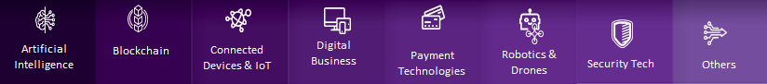
Technology is disrupting all sectors
Consumer | #Virtual Assistants #Customer Engagement | #Direct to consumer #Counterfeit Detection | #Smart Homes #Consumer Wearables | # Digital Commerce # Sharing Economy | #Digital Wallets #Virtual Currency | #In-home Robots #Autonomous Vehicles | #Home Security #Intrusion Prevention | #Social Analytics #3D Printing
Retail | #Bots #In-store Experience | #Warranty Management #Inventory Tracking | #Store Management #Smart Warehouse | # Virtual Stores #Ambient Commerce | #Mobile Wallets #Biometric Payments | #Drone Delivery #In-store Robots | #Biometric Authentication #Smart Store | #VR/AR Experience #Customer Analytics
Financial Services | #Credit Scoring #Fraud Detection | # Crypto Currency #P2P Payments | #Telematics #Wearables for Banking | #P2P lending #Digital Banks | #Biometric Payments #Wearable Payments | #Robo Advisers #RPA | #Vulnerability Management #Biometrics | #Predictive Analytics #Financial Mgmt. Platform
Healthcare | #Diagnosis & Detection #Drug Discovery | #Electronic Health Records #Counterfeit Drug Detection | #Mobile Health #Sensors | #Appointment Management #Lifestyle Monitoring | #Automated Claim Processing #Digital Health Wallets | #Robotic Pills #Surgical Robots | #Patient Data #Network Security | #Genomics #Bionics
Decoding Disruptor Tech IC

Slide 5





























Technology-enabled companies’ business model is
to disrupt entire industries and achieve maximum scale
Consumer
Retail
Decoding Disruptor Tech IC
Notes:
Alexa is an intelligent personal assistant developed by Amazon, first used in the Amazon Echo and the Amazon Echo Dot devices
Clarabridge recommends solutions to common customer issues and feedback using AI
INS is a global decentralized grocery marketplace powered by Blockchain enabling B2C Selling
Chronicled leverages Blockchain and IoT to power smart, secure supply chain solutions
Netatmo designs and develops connected consumer electronics.
Jawbone develops and sells wearable technology and portable audio devices.
Elastic Path builds commerce software that powers the next generation of digital experiences
Didi Chuxing is a leading mobile transportation platform in China
Adyen is a multichannel payment company outsourcing payment services to international merchants.
Coinbase is a digital currency wallet that allows traders to buy and sell bitcoin.
SoftBank Robotics Holding Corp. is the SoftBank Group's subsidiary responsible for its robotics business
Waymo is an autonomous car development company and subsidiary of Google's parent company
Qualcomm is a telecommunications equipment company that designs and markets wireless telecommunications products and services.
Trend Micro provides enterprise data security and cyber security solutions for businesses
Hootsuite is a social media management platform
Materialise provides software solutions and 3D printing services for medical and manufacturing
Slack is an enterprise software platform that allows effective communications across businesses
Oak Labs develops in store technology for physical retailers
Warranteer connects consumers to vendors & allows warranty activations to create a new revenue stream
IBM Blockchain is a public cloud service that customers can use to build secure Blockchain networks
Xively delivers enterprise IoT platform for connected product or service
Zebra develops enterprise-level data capture and automatic identification solutions
Symphony’s portfolio of solutions translates customer intelligence into insights to drive execution.
Sentiance provides an SDK that creates user behavior profiles by analyzing sensor data, helping companies to deliver personalized and context-aware customer engagement
Amazon Pay is an online payments processing service that is owned by Amazon.com, Inc..
Nymi Inc. develops and delivers Nymi Band, a wearable electrocardiogram authenticator
Flirtey is real-time delivery service that uses drones to make delivery possible to everyone.
Bossa Nova creates service robots for the retail industry
Cross Match provides biometric identity management solutions
Noccela specialises in Electronic Article Surveillance and retail security
Ikea Place is an AR app to help customers visualize what their furniture might look like in their own living rooms.
Fractal provides services to organizations for data-driven decision-making.

Slide 6
































Technology-enabled companies’ business model is
to disrupt entire industries and achieve maximum scale
Financial Services
Healthcare
Decoding Disruptor Tech IC
Notes:
FICO provides products and services that enable businesses to automate, improve, and connect decisions to enhance business performance through decision management and predictive analytics.
H2O.ai provides an open source machine learning platform that makes it easy to build smart applications to predict fraud, customer churn, etc.
Ripple offers a global real-time Blockchain based payment system for financial institutions.
FIS is a provider of technology-based banking and payment solutions for the financial services industry.
Zubie is a connected-car app that provides location tracking, driver scoring, alert and location sharing services for consumers.
Apple Watch is a line of smartwatches designed, developed, and marketed by Apple Inc that incorporates fitness tracking and health-oriented capabilities.
Lending Club is an online financial community that brings together creditworthy borrowers and savvy investors.
Atom Bank is a mobile banking application that offers a range of personal and business banking products.
Zwipe is a technology company that is making biometrics easy by developing and commercializing award-winning biometric authentication solutions for three key areas: payment, access control, and ID.
Alipay provides secure, online and mobile payment services.
Betterment is a goal-based online investment company, delivering personalized financial advice paired with low fees and customer experience.
UiPath is a robotic process automation software vendor
ThreatMetrix is an integrated digital identity platform that allows its users to transact their businesses without friction.
M2SYS Technology is a global biometric identification management company, providing enterprise multi-modal biometric solutions.
Alteryx Analytics provides analysts with ability to easily prep, blend, & analyze all data using a repeatable workflow.
Kreditech uses machine-learning technologies to provide access to better credit for the underbanked for digital banking services.
Infermedica is a health AI company that improves the diagnostic process using the most advanced reasoning technology for preliminary medical diagnosis.
Recursion Pharmaceuticals is combining high-throughput experimental biology, bioinformatics, and machine learning to rapidly identify new indications for many known drugs and shelved assets.
Guardtime is a software security company that developed a digital signature system based on Blockchain technology.
BlockVerify believes in the potential of Blockchain technology to improve anti-counterfeit measures in different industries and have a significant positive social impact.
AliveCor has a device and application that will turn any smartphone into a clinical-quality electrocardiogram (ECG) recorder.
Fitbit offers compact, wireless, wearable sensors that track a person’s daily activities in order to promote a healthy lifestyle.
Patients use Zocdoc to find in-network neighbourhood doctors, instantly book appointments online.
FitnessKeeper offers Runkeeper, a mobile platform that employs location technology to allow users to track their workout performance.
PegaSystems provides business process and customer relationship management solutions for organizations.
InstaMed simplifies every healthcare clearinghouse and payment transaction for providers and payers, all in one place.
Rani Therapeutics develops bio-therapeutics technology for the oral delivery of large drug molecules.
Intuitive surgical is a developer of robotic-assisted minimally invasive surgery (MIS) techniques and tools.
ClearDATA is the trusted managed cloud provider, designed for today’s healthcare security needs.
Secureworks manages medical identity theft, IoT security threats, and ransomware in healthcare organizations.
23&me is a human genome research company enabling users to study their ancestry, genealogy, and inherited traits.
Ekso Bionics develops wearable exoskeletons for military, civilian and medical uses that augment strength, endurance and mobility.

Slide 7

Decoding disruptive innovation
GlobalData’s Disruptor is the leading market intelligence service that decodes emerging tech-enabled opportunities by providing must-have information on promising start-ups, tech-led innovations, latest tech/sector trends, consumer insights, and venture capital portfolio investments.
Six ways in which Disruptor drives success
in a disruptive world
Monitor competitor
strategies
Monetize disruptive
innovation
Mine thought leadership
Predict emerging
trends
Decode smart
money
Capture digital
consumers
Decoding Disruptor Tech IC

Slide 8
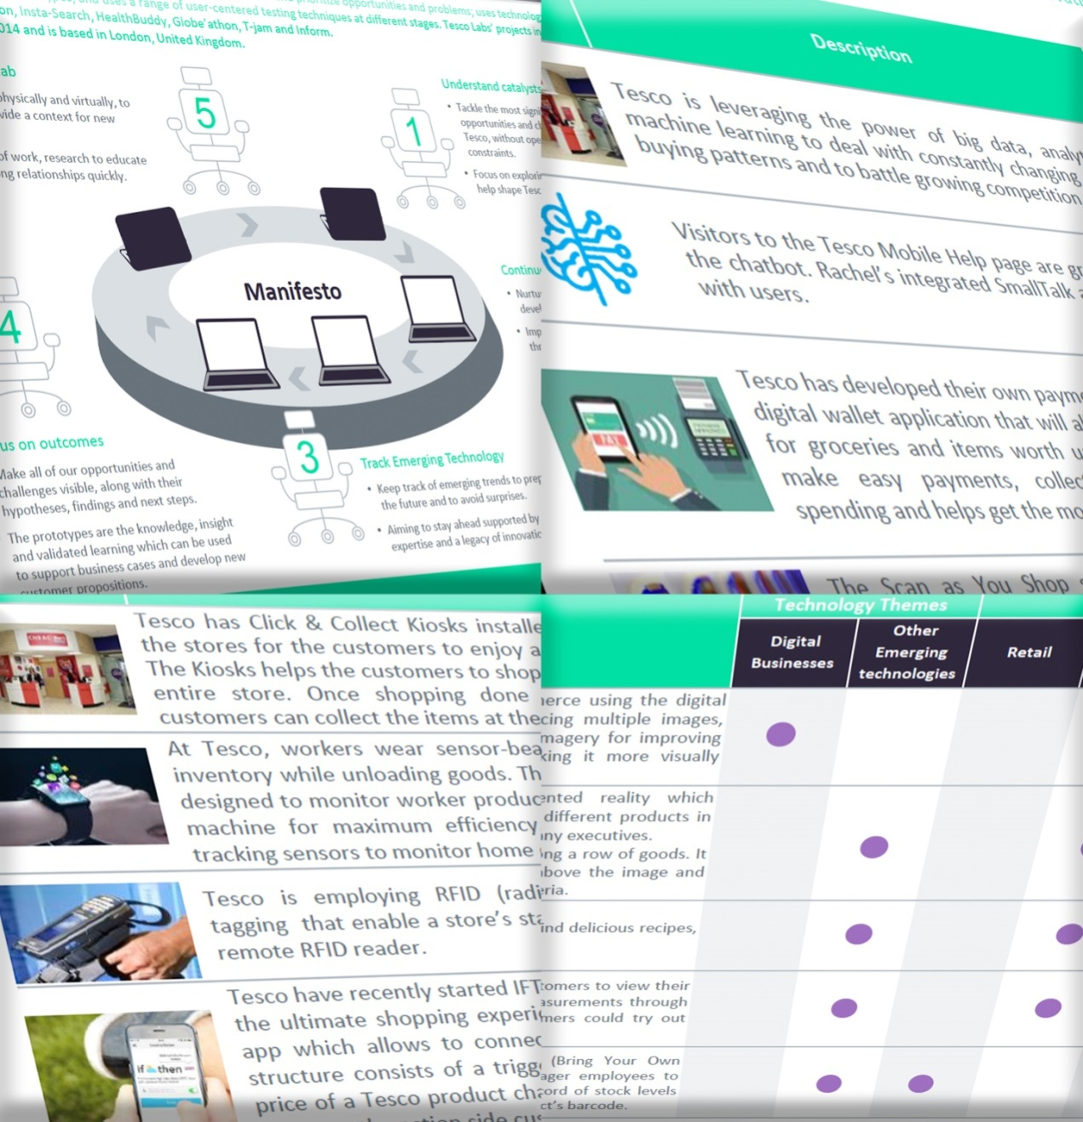











































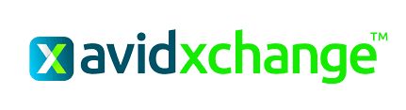
Monitor competitor strategies
Anticipate emerging competitive threats and future-proof your business
Pinpoint the emerging disruptors shaping technological change
Decode competitor strategies to avoid predictable surprises
Stay up-to-date with competitors’ key digital disruption developments
Screenshot of platform – will speak to Becky
Robotics & Drones
Blockchain
Other Emerging Technologies
Digital Businesses
Disruptive Tech
Incumbent &
Startup landscape
Connected Devices & IoT
Security Technologies
Gain access to:
A database of more than 40,000 start-ups
50 Competitor Ecosystem Reports per year
Expert opinion from 500+ GlobalData analysts
Artificial Intelligence
Payment Technologies
Decoding Disruptor Tech IC

Slide 9
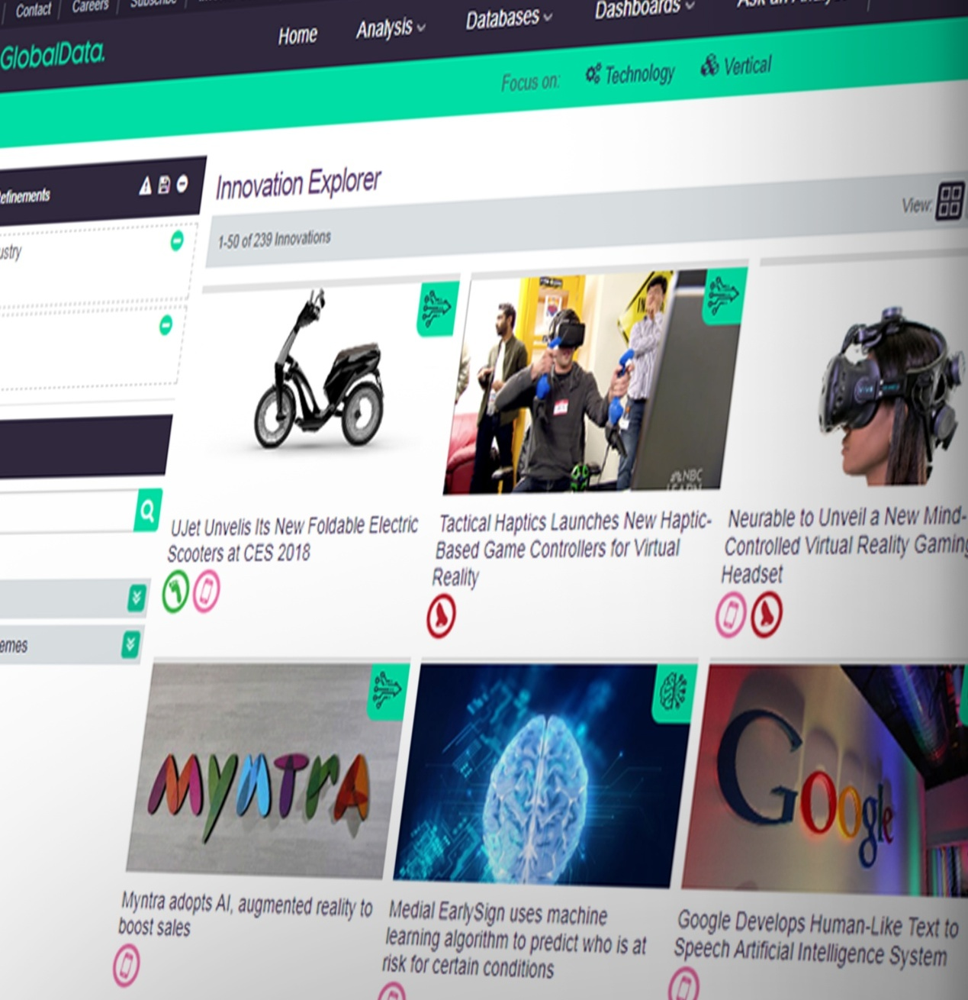
Monetize disruptive innovation
Learn from real-world,
high-impact innovation case studies
Track the latest innovations leveraging disruptive technologies across sectors
Monitor competitor activity and stay ahead of innovation trends
Contextualize innovation best practices and monetise Disruptive Innovation
Stay on the pulse with latest developments
Inspire innovation by understanding the true nature of latest disruptions
Gain access to:
Over 1,500 innovation profiles
300+ new innovation profiles every month
50 Disruptor Case Studies per year
Decoding Disruptor Tech IC

Slide 10
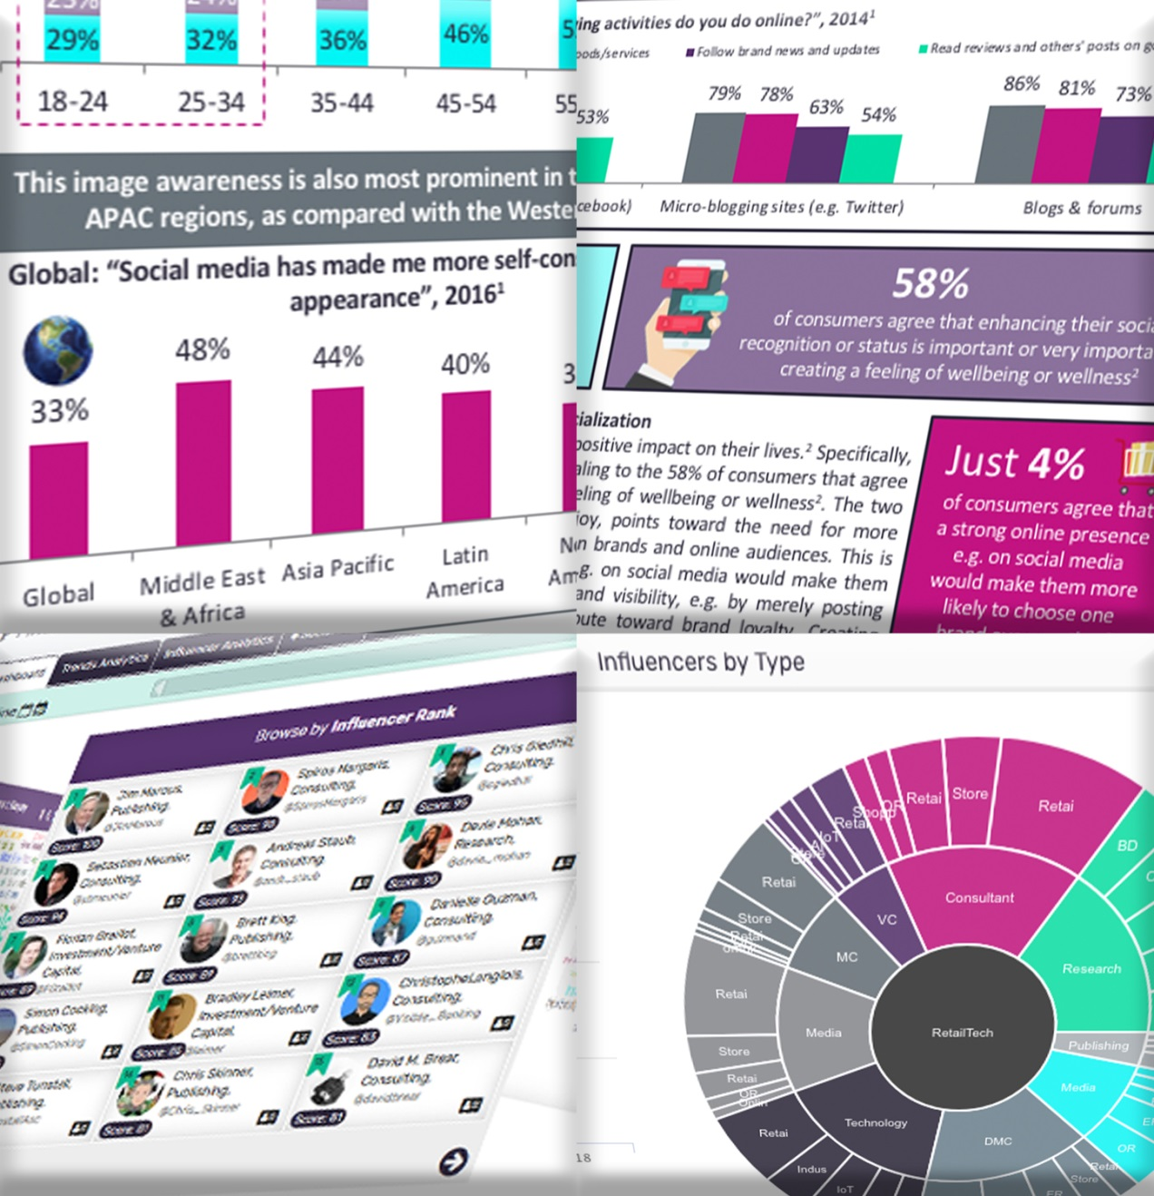
Mine thought leadership
Distinguish reality from media hype
Cut through the noise in social media by focusing on what matters
Identify critical insights from the top Influencers per sector via our Influencer Tool
Protect & grow your brand equity
Stay in touch with latest developments with real time updates
Gain access to:
Top 100 Influencers per sector (Fintech, HealthTech, DisruptiveTech, RetailTech)
Analyzing 200,000+ tweets per quarter
1,000+ analyst opinions per year
Decoding Disruptor Tech IC

Slide 11
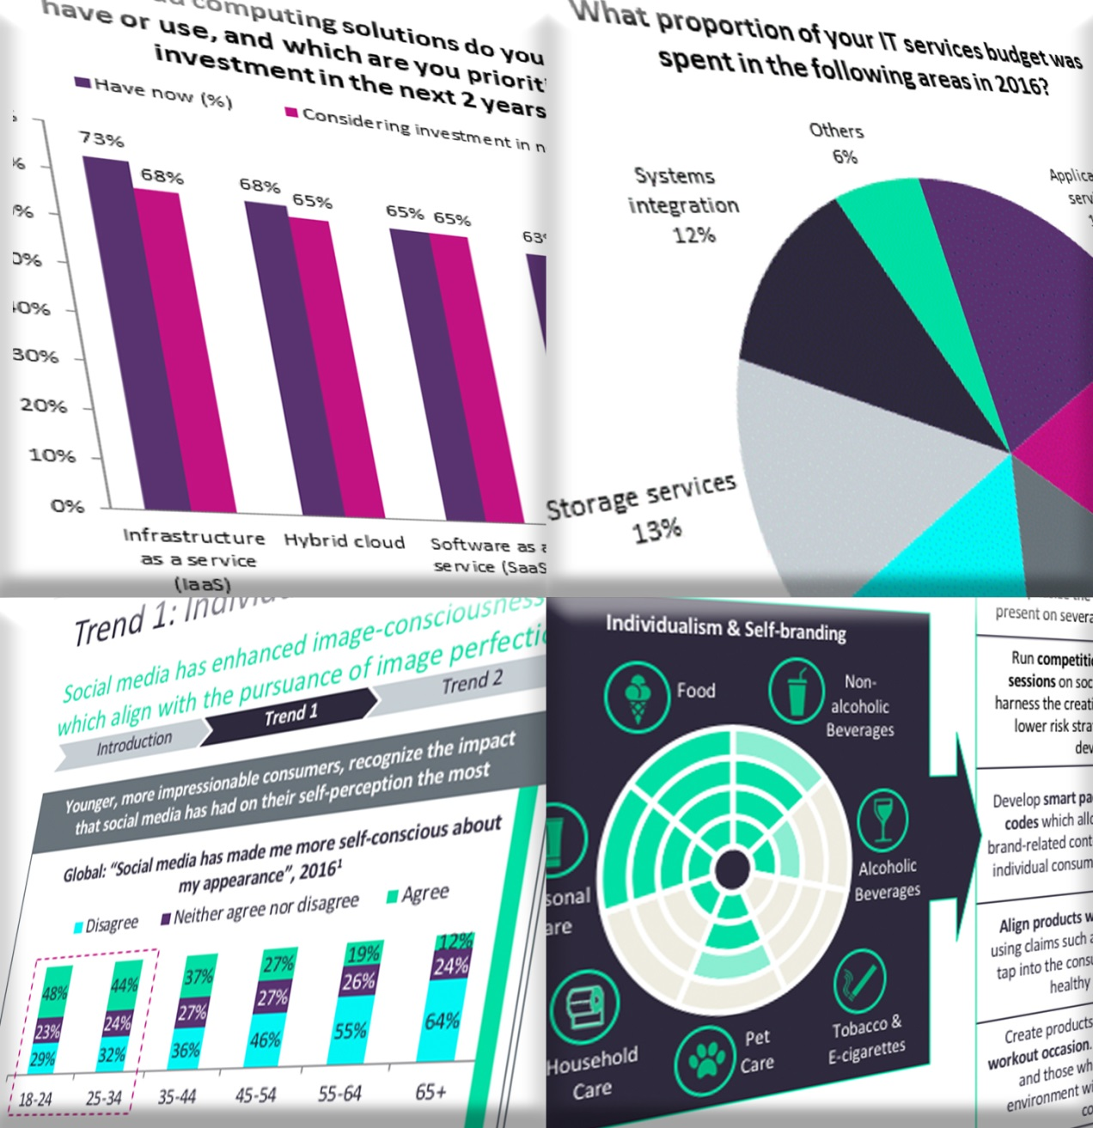
Predict emerging trends
Stay ahead of the curve by uncovering emerging trends
Identify the players and technologies that will disrupt your core business
Diversify & expand beyond your core: identify your next market
Identify the key technologies in which your customers and competitors are investing
Uncover emerging trends before the competition and get ahead in the digital race
Gain access to:
100+ Digital Trends Reports per year
50+ monthly newsletters across core verticals per year
Expert opinion from 500+ GlobalData analysts
Decoding Disruptor Tech IC

Slide 12
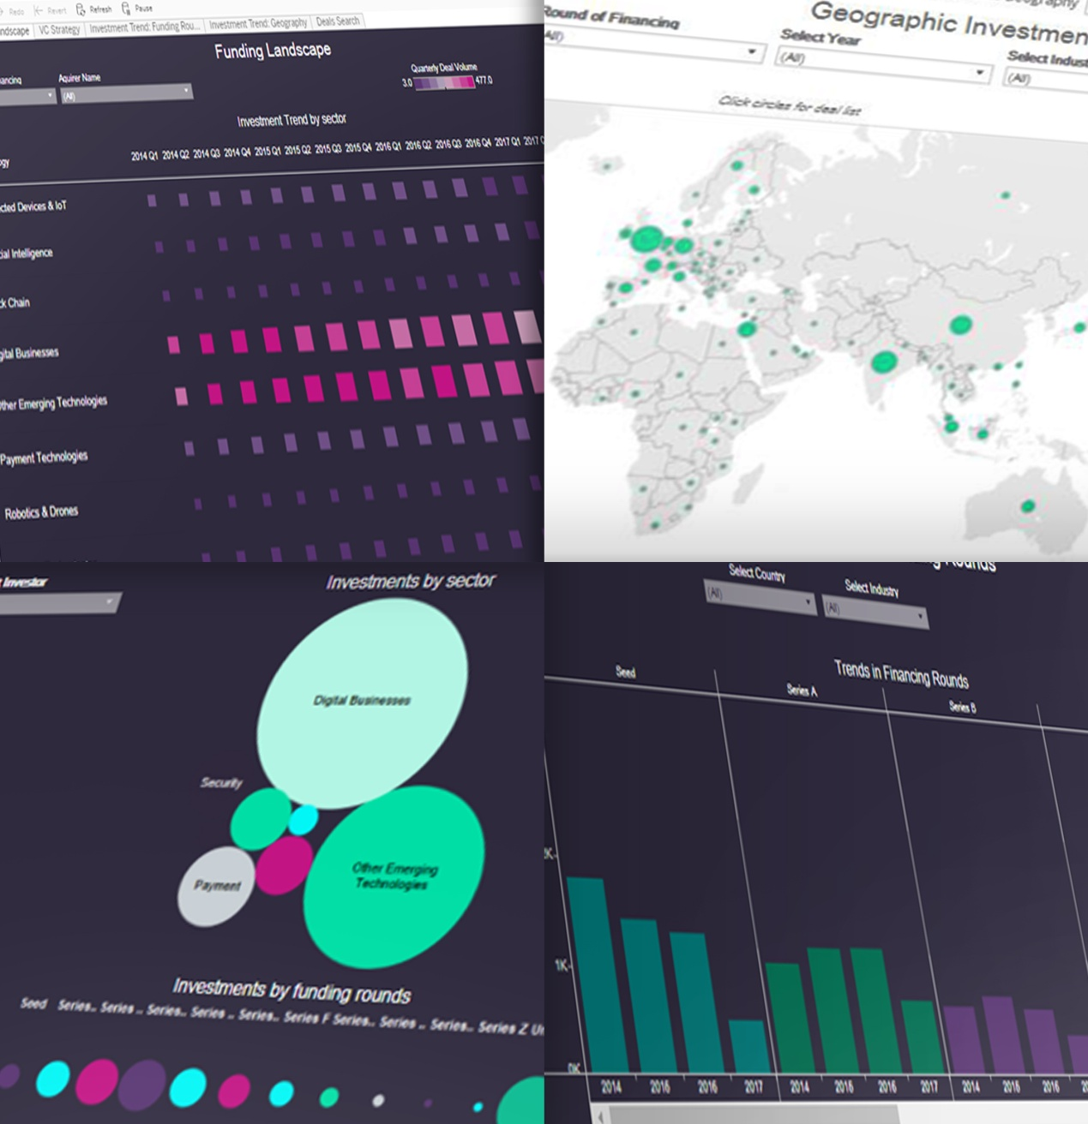
Decode smart money
Make sound investment decisions in
next-generation technologies
Build your partnership ecosystem to achieve disruption objectives
Identify and monitor potential partners that will transform your disruptive capabilities
Track and trace venture capital investments into disruptive tech
Unpick key investor portfolios and identify hot start-ups by market, funding rounds, and investor sector
Gain access to:
A database of more than 40,000 start-ups
14,000 venture capital and private equity firms
20 Smart Money Reports per year
Decoding Disruptor Tech IC

Slide 13
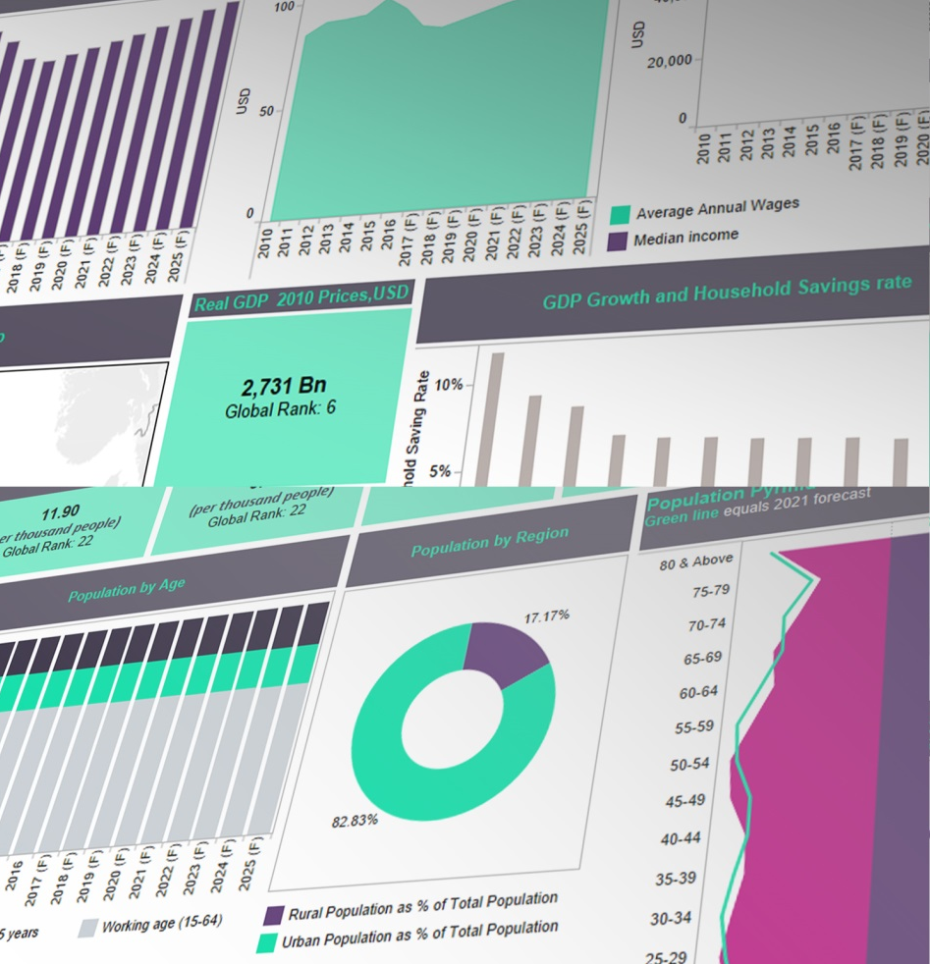
Capture digital consumers
Deliver next-generation customer experiences
Understand the motivations of the ultimate driver
of market change – the consumer
Identify the requirements of the consumer of
the future
Anticipate customer needs and deliver next-generation products and services
Identify latest trends and attitudes with techno-economic data on markets and consumers
Access expert reports and insights curating latest consumer surveys and interviews
Gain access to:
Techno-economic data on 40+ countries
Consumer behavior survey across 36 countries & 26,000 respondents
Fintech Adoption & Awareness survey across 28 countries and 22,000 respondents
Decoding Disruptor Tech IC

Slide 14

Succeeding in a disruptive world
Access a complete offering with the intelligence, insights and opinions that will enable your business to win in a disruptive world.
COMPANIES
MARKETS
INNOVATION
CONSUMERS
INTELLIGENCE
Monitor
competitor strategies
Monetize
disruptive innovation
Start-ups database of 40,000+ companies
Smart Money Investments
Over 1,500 innovation profiles
Latest technology news & deals activity coverage
Mine
thought leadership
Consumer Survey Data & Adoption Studies
100+ Digital Trends Reports per year
50 Competitor Ecosystem Reports per year
50 Disruptor Case Studies per year
Predict
emerging trends
Techno Economic Data for 40+ countries
500+ analyst opinions per year
50+ monthly newsletters across core verticals per year
Decode
smart money
Expert opinion
from 500+ GlobalData analysts
Innovation Landscape Reports
Top 100 Influencers per sector
Tech Maturity Framework
Capture
digital consumers
Decoding Disruptor Tech IC
14

Slide 15

Comprehensive coverage across technology segments & verticals
Technology data complemented by in-house expertise in vertical industries like Healthcare, Consumer, Retail and Financial Services.
Trending Disruptive Tech Segments
Our Intelligence
Center delivers all our services through a single platform, with combined search, browse, and alert functionality.
Artificial Intelligence
Blockchain
Connected Devices & IoT
Digital Business
Payment Technologies
Robotics & Drones
Machine Learning
Natural Language Processing
Decision Management …
Financial Markets
Data Sharing
Identity Management. …
Connectivity Platforms
Beacons
NFC …
E Commerce
Social Platforms
Apps & Platforms….
Crypto Currency
POS
Digital Wallets …
Autonomous Vehicles
Smart Robots
Commercial UAVs …
Security Tech
Others
Consumer
Retail
Financial Services
Healthcare
Technology
Vertical
Fraud Protection
User & End Point Behavioral Analytics
IOT Security …
3D Printing
Enabling Solutions
Analytics …
Smart Homes
Mobile Wallets
Wearables…
Payment Platforms
Augmented/Virtual Reality
Digital Content Recognition …
Chatbots
Peer-to-Peer Payments
Marketplaces…
Genomics
Mobile Medical Devices
Electronic Patient Records….
Decoding Disruptor Tech IC

Slide 16
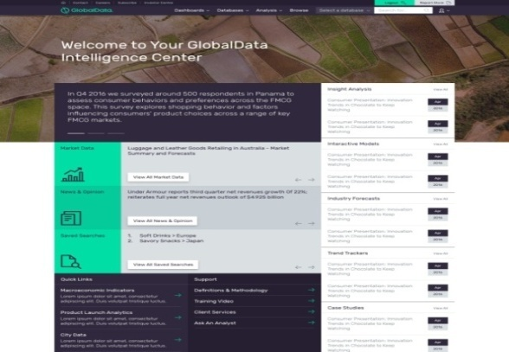
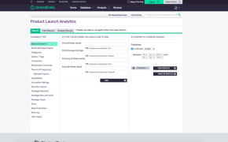
Single platform, expert tools –
seamlessly integrate into your workflow
Our Intelligence Center offers a mix of data visualization, analytical tools, presentations, reports and export tools to slot seamlessly into your workflow.
Ease of Access
Intuitive data search and advanced filtering functionality to find the right information quickly
Easy ways to download and export content to the formats you need (data, charts, images & text)
Embedded Analytics
Strong analytical capabilities
Granular databases
Direct access to analyst teams
User -friendly interactive tools
Competitor and product comparisons
Technology and industry dashboards.
Clipping & report building functionality
Embedded
In Workflows
Data sharing and collaboration tools
Automated alerts on new & updated content in your interest areas
Decoding Disruptor Tech IC

Slide 17

Methodology – our technology backbone
A combination of machine learning algorithms, advanced data mining capabilities and expert analysis guarantees reliable and insightful outputs, enabling your business to confidently make decisions that will drive top-line growth.
AUTOMATION
2
Automation steps , including:
Crawling
Classifying
Extraction of entities
Tagging
Publishing
ENTITY RECOGNITION ENGINE
1
Identifying and categorizing key information and metrics: organizations, people, dates, investment, places etc across multiple sources.
EXPERT ANALYSIS
5
A combination of 500+ technology and sector-level experts interpreting data in order to provide context for taking business decisions that win.
DATA ANALYSIS
& VISUALIZATION
3
Analyzing more than 200,000 sources on a daily basis in order to identify trends and insights.
MACHINE LEARNING
4
Machine learning-based algorithms combining pattern matching, deep data mining and extractions.
Decoding Disruptor Tech IC

Slide 18

Contact us
GlobalData has a global network of offices.
EUROPE
London
John Carpenter House
7 Carmelite Street
London
EC4Y 0BS
+44 207 936 6400
Basingstoke
4th Floor, Northern Cross
Basing View, Basingstoke,
Hampshire, RG21 4EB,
UK
+44 1256 394200
Hull
GlobalData PLC
Shirethorn House
37-43 Prospect Street
Hull
HU2 8PX
Manchester
GlobalData PLC
Churchgate House
Manchester
M1 6EU
+44 161 359 5813
Madrid
C/Jesusa Lara, 29 - Atico J,
28250 Torrelodones Madrid,
Spain
+34 91 859 4886
Paris
Les Bureaux de Sevres
2, rue Troyon
92316 Sevres
France'
NORTH AMERICA
Boston
41 Farnsworth St,
Boston, MA 02210
USA
+1 781 762 9450
New York
441 Lexington Avenue,
New York, NY 10017
USA
+1 646 395 5460
San Francisco
425 California Street
Suite 1300
CA
94104
USA
+1 415 800 0336
Toronto
530 Richmond st West
Suite 300
Toronto
Ontario
M5V 1Y4
Canada
+1 703 788 3592
Virginia
9870 Main Street,
Fairfax,
Virginia 22031
USA
Toll-free in USA:
+1 888 777 9940
Direct: +1 703 383 4903
Fax: +1 703 383 4905
CENTRAL & SOUTH AMERICA
Bogota
Calle 71,
No 5-23 Suite 501 D
+571 3470749
Buenos Aires
Basavibaso 1328, 2nd Floor
Off 206, Buenos Aires, 1006
CA
Argentina
+54 11 4311 5874
Mexico City
Mote Pelvoux 111-2 Piso
Lomas de Chapultepec
Mexico D.F, 11000
Mexico
+52 55 5284 2945
Sao Paulo
Rua Juranda, 199 – Vila Madalena
Sao Paulo – SP
05434-000
Brazil
+55 11 3812-5302
ASIA
Beijing
Room 2301 Bulding 4
Wanda Plaza, No 93 Jianguo Road
Chaoyang District
Beijing 100026, PR China
+ 86 10 6581 1794
+86 10 5820 4077
Hyderabad
KRISHE SAPPHIRE,
MSR Block, 3rd Floor,
Madhapur, Hyderabad-500081,
Telangana, India.
+91 40 6616 6700
Hong Kong
1008 Shatin Galleria
18-24 Shan Mei Street
Fo Tan, New Territories
Hong Kong S.A.R
+852 2690 5200
+852 2690 5230
Seoul
24th floor, City Air Tower,
Teheranro 87gil
36, Samsung Dong,
Gangnam Gu, Seoul,
Republic Of Korea
(Postcode 06164)
T: +82 2 2016 6070
M: +82 10 8976 2437
F: +82 2 2016 5411
Shanghai
Room 408, Jing'an China
Tower No: 1701,
West Bejing Road
Jing'an District, 200040,
Shanghai, PR China
+86 21 5157 2275(6)
Singapore
1 Finlayson Green
#09-10
049246
Singapore
+65 6383 4688
+65 6383 5433
Tokyo
Level 3,
Sanno Park Tower,
2-11-1 Nagata-cho,
Chiyoda-ku,
Tokyo, 100-6162
Japan
T: +81 3 6205 3511
F: +81 3 6205 3521
AUSTRALIA
Melbourne
Suite 1608
Exchange Tower
Business Centre
530 Little Collins Street
Melbourne
3000, Victoria, Australia
+61 3 9909 7757
+61 3 9909 7759
Sydney
Suite 602, level 6
45 Clarence St
Sydney 2000
Australia
+61 2 8076 8815
MIDDLE EAST
Dubai
Dubai Media City
Building 7, Floor 3, Office 308
PO Box 502635
Dubai
United Arab Emirates
+971 4391 3049
Decoding Disruptor Tech IC

Slide 19
Appendix
GlobalData story

Slide 20
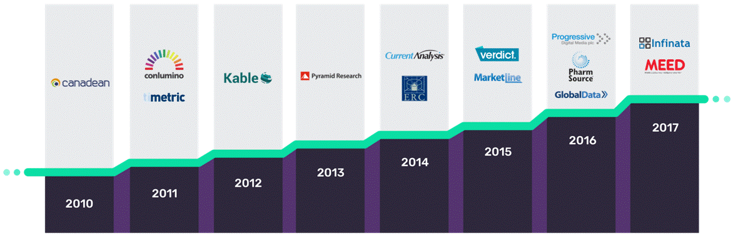
GlobalData history
GlobalData, incorporated in 2016 based on brands with a long history, has now become the fastest growing Data & Analytics company in the LSE – 65% growth in 2016 and $600M market cap.
Acquisition Timeline
Company Creation
Date
1972
2011
2012
1996
1986
1997
1961
1984
1999
1999
1996
2006
1999
1957
Decoding Disruptor Tech IC

Slide 21

Who we are
GlobalData is a leading Data & Analytics company who, for over 40 years, has been helping over 4,000 organizations worldwide to make better and more timely decisions.
OUR PEOPLE
2,440 employees in 23 offices worldwide
1,200 researchers
600 global analysts supporting clients
1-on-1 more than 315,000 times a year
145 client services and account managers driving 90% renewal rates
70 journalists
OUR DATA & INSIGHTS
Real time tracking of 200,000+ companies, 70,000 M&A deals, 117 technologies, 25,000 industry opinion leaders and 2M new product innovations across 200 countries & 2,000 cities
540,000 consumer survey responses
Publishing 13,000 reports annually, including databooks
Quoted c.20,000/year by business press e.g.
FT, SKY News & Bloomberg
OUR CLIENTS
Serving 4,000 of the world’s leading companies in 160 countries
73% of the FTSE 100 companies
60% of Fortune 100 companies
66% of DJ Asian Titans 50 index
Our mission is to help our clients decode the future
to be more successful and innovative
Decoding Disruptor Tech IC

Slide 22

















A unique view of your value chain
We work with over 4,000 organizations worldwide
“The research GlobalData
provides is of significant value,
and is the key source of a lot of
market intelligence for us.”
TECHNOLOGY
FINANCIAL SERVICES
CONSUMER
“I’ve set up my own
profile on GlobalData specific
to my needs, and find
the service very useful.”
I find GlobalData
an invaluable source of
relevant information... it is the
only information source
I rely on for good,
honest detail.”
HEALTHCARE
4,000 pharmaceuticals, biotech
and medical devices organizations
Decoding Disruptor Tech IC
Notes:
Kept some client testimonials from tech segment clients

Slide 23
Appendix
Features

Slide 24



How to win in Digital Disruption
Your trusted partner in a disruptive world
500+
START UPS
40,000+
ANALYSTS
Healthcare
Consumer
Retail
Financial
Services
Other
1,500+
INNOVATION EXAMPLES
500+ INFLUENCERS AND OPINION LEADERS
Experienced Industry Hires
Top 100 Global University Recruits
Primary & Secondary Research Teams
Artificial Intelligence
Blockchain
Connected Devices & IoT
Other
Digital Businesses
Payments Tech
3,000+ B2B SURVEY
RESPONSES & FINDINGS
Global Presence
Robotics & Drones
Security Tech
London
Boston Hyderabad Singapore
Sao Paulo
Buenos Aires
Kuala Lumpur
Sydney
Paris
Hong Kong
Shanghai
Seoul
New York
Dubai
Singapore
San Francisco Mexico City
REPORTS & BRIEF
350+ Reports & Briefs
NEW & DEALS
Repository of 150,000+
News & Deals
Decoding Disruptor Tech IC

Slide 25
Succeeding in a disruptive world
Access a complete offering with the intelligence, insights and opinions that will enable your business to win in a disruptive world.
Monitor competitor strategies
Predict emerging trends
Digital Trends Reports
Monthly Newsletters
Stay up-to-date with
key digital disruption developments
Decode competitors’
strategies
Company Landscape
Competitor Ecosystem Reports
News
Identify the player and technologies disrupting
core business
Identify your next market
Monetize disruptive innovation
Decode smart
money
Launch innovative
products to stay ahead
of competitors
Make sound investment decisions with next
generation technologies
Build partnership ecosystems
Innovation Explorer
Disruptor Case Studies
Smart Money Analytics
Deals Landscape
Mine thought leadership
Capture digital consumers
Protect and grow
your brand
Identify main issues
of social media
Identify the consumer
of the future
Anticipate customer needed
Deliver next generation customer experience
B2B & B2C Surveys
Techno-economic Data
Influencers
Analyst Opinions
Decoding Disruptor Tech IC

Slide 26
Providing custom support
Our CONSULTING offering provides tailored solutions to help clients identify new growth opportunities, minimize risk, gain competitive advantage, and improve profitability.
GLOBAL REACH, LOCAL INSIGHT
INNOVATION & INSIGHT
INNOVATION & INSIGHT
OPPORTUNITY ASSESSMENT
MARKET & PRODUCT STRATEGY
MARKET & PRODUCT STRATEGY
MARKETING COMMUNICATIONS
MARKETING COMMUNICATIONS
FINANCIAL ANALYSIS
FINANCIAL ANALYSIS
REGULATORY, TRADE
& INDUSTRY
BOSTON
LONDON
HYDERABAD
SYDNEY
REGULATORY, TRADE
& INDUSTRY
COMPETITIVE & COMPANY
ANALYSIS
COMPETITIVE & COMPANY
ANALYSIS
OUR GLOBAL REACH
Delivering value for companies across all regions globally
OUR PEOPLE
A team of eight management consultants specializing in diverse sectors
OUR PROJECTS
50+ completed projects in the last two years
OUR CLIENTS
Successfully delivered consulting solutions to market-leading FS companies in every sector
FORECASTING
FORECASTING
Decoding Disruptor Tech IC

Slide 27
Appendix
Methodologies

Slide 28
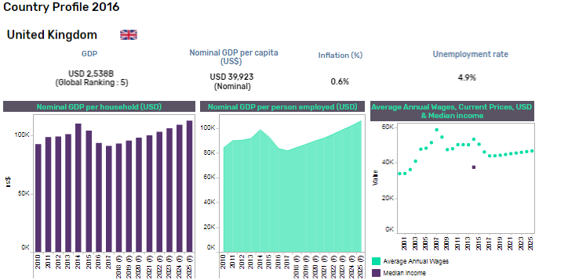
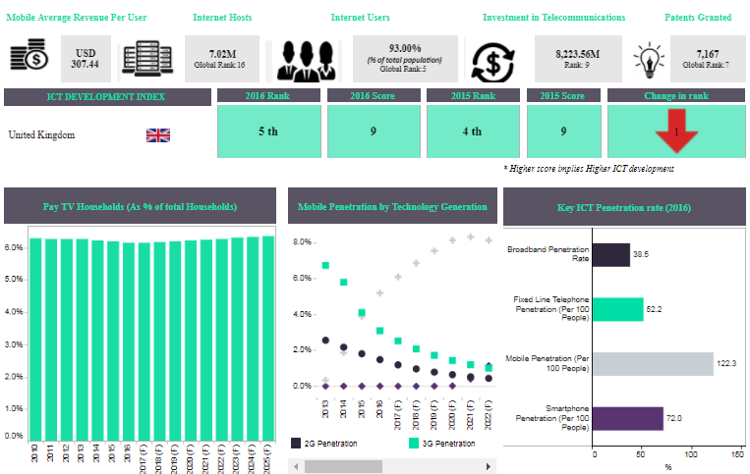
Methodology – techno-economic analytics
COUNTRY RESEARCH
DATA MODELLING
RIGOROUS FORECAST
Time series data from global institutes e.g. United Nations Statistics Division, World bank, US Census Bureau, Eurostat, IMF, and OECD.
Comparative and trend analysis of historical data is carried out to provide best fit values for each country.
Linear regression methods, as well as simple and linear exponential smoothing are leveraged to arrive at forecasting numbers.
Forecasted time series data are updated in econometric models after passing through relevant quality checks for consistency and flow.
Data series for each country are benchmarked with renowned sources e.g. IMF, OECD, World Bank to ensure a robust forecast.
Decoding Disruptor Tech IC

Slide 29

Methodology – framework scoring
MARKET READINESS
SEGMENT TECHNOLOGIES
A market readiness score is provided using the following criteria:
Ecosystem readiness (state of the vendor community, extensible platforms, maturity standards, established deployment and consumption models, contained costs)
Customer readiness (established customer and geographic deployment bases, industry support,, breadth of industry expertise)
A score is provided on a scale of 0-10
Each technology is segmented into
a set of individual use cases
Vendors supporting each use case are identified
2
1
IGNORE. EXPLORE. INVEST.
Use cases are segmented into three groups:
Ignore – market not ready / no business impact
Explore – requires further investigation
Invest – high degree of market readiness and business impact
Conclusions based on:
Market demand
Feedback from cross-section of enterprises
Expert analyst insights
BUSINESS IMPACT
3
A business impact score is determined using the following criteria:
Cost reduction
Revenue growth
Proof points around market impact (displacement of older technologies, impact on competing technologies and vendors, and market projections)
A score is provided on a scale of 0-10
4
Decoding Disruptor Tech IC

Slide 30
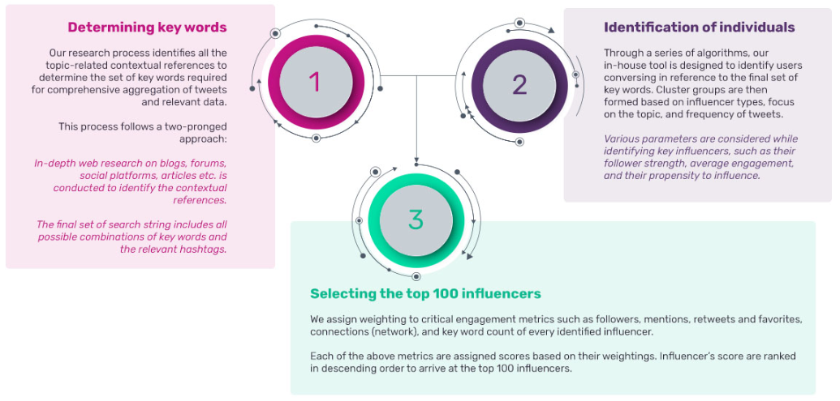
Influencers methodology (1/2)
The Influencers tool is based upon two main stages of Influencer identification, followed by analysis of the topics and level of influence of this group.
A three step process is followed: Initially, an exhaustive list of keywords is determined to define a project area . This set of
keywords is then used as an input to a proprietary algorithm that results in a detailed list of the key individuals associated with these
keywords. Finally, a series of algorithms is then used to determine the 100 most important influencers within this initial list.
Decoding Disruptor Tech IC

Slide 31
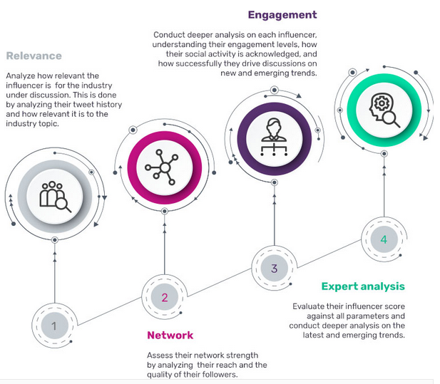
Influencers methodology (2/2)
In the second and third stages of the process, a series of parameters are analyzed based on key pillars of relevance, network and engagement.
GlobalData’s proprietary Influencer Identification Framework is based on a scientific process that works on
pre-defined parameters using our proprietary algorithms.
Our multi-stage methodology works on the pillars of relevance, network, engagement, and our deep analysis by evaluating the following parameters:
Relevance – Tweets relevant to our subject; the number of times influencers use relevant and most appropriate keywords in their tweets
Network – Number of followers; connections within the shortlist of influencers
Engagement – The number of times tweets are
re-tweeted; the number of times influencers are mentioned
Expert analysis – A combination of proprietary algorithms as well as inputs from in-house sector experts
Decoding Disruptor Tech IC

Slide 32

Innovation Explorer – methodology
Tracking key vendor websites, emerging disruptors, award-winning technology companies, and the venture capital universe in order to provide real-world disruptive innovation examples that help clients transform disruption into top-line growth.
The way in which we capture data for the Innovation Explorer involves a top-down approach consisting of the following steps:
Tracking innovations across eight emerging technology themes:
Grouping applications at an industry and vertical level
Categorization of trends associated with the identified innovations e.g. Health & Wellness, Individualism & Expression, Smart & Connected
Identifying the impact in terms of concept, nature of disruption, and outlook
Our selection process focuses on new investment opportunities, concept and beta-stage ideas, as well as product launches.
Artificial Intelligence
Blockchain
Connected devices & IoT
Digital business
Payment technologies
Robotics & Drones
Security technology
Others
Our Influencers database, tracking the top 100 global thought leaders across
various industries, enables
us to understand potential areas where disruptive innovations are emerging.
We also track research updates from leading universities and institutes, as well as key global events and exhibitions.
Decoding Disruptor Tech IC

Slide 33

Company landscape – selection approach and methodology
Our database hosts profiles for over 40,000 high-impact companies, leveraging a robust selection process to identify the most disruptive technology companies.
Analyst Picks – screening listed companies via multiple in-house expert analysts who pinpoint only the most disruptive and innovative
start-ups across technologies and verticals
GlobalData Venture Capital funding database – tracking disruptive technology start-ups either on the VC radar or already receiving funding
Key industry awards – tracking winners of prominent industry awards such as: Deloitte FAST 500, Digital Health Awards, Finnovate Awards, MedTech Breakthrough Awards, CNBC Disruptor 50, CIO Reviews, CES Innovation Awards
Key accelerator programs – monitoring participants of world-renowned accelerator programs from industry leaders such as:
Y Combinator; 500 Startups; and Plug & Play
Decoding Disruptor Tech IC

